Slide 1
Object-Oriented Software Engineering
Practical Software Development using UML and Java
Chapter 3:
Basing Software Development on
Reusable Technology

Slide 2
3.1 Building on the Experience of Others
Software engineers should avoid re-developing software already developed
Types of reuse:
  Reuse of expertise
  Reuse of standard designs and algorithms
  Reuse of libraries of classes or procedures
  Reuse of powerful commands built into languages and operating systems
  Reuse of frameworks
  Reuse of complete applications
© Lethbridge/Laganière 2005
Chap. 3: Basing Development on Reusable Technology

Slide 3
3.2 Reusability and Reuse in SE
Reuse and design for reusability should be part of the culture of software development organizations
But there are problems to overcome:
  Why take the extra time needed to develop something that will benefit other projects/customers?
  Management may only reward the efforts of people who create the visible ‘final products’.
  Reusable software is often created in a hurry and without enough attention to quality.
© Lethbridge/Laganière 2005
Chap. 3: Basing Development on Reusable Technology

Slide 4
A vicious cycle
Developers tend not develop high quality reusable components, so there is often little to reuse
To solve the problem, recognize that:
  This vicious cycle costs money
  Investment in reusable code is important
  Attention to quality of reusable components is essential
    So that potential reusers have confidence in them
    The quality of a software product is only as good as its lowest-quality reusable component
  Developing reusable components can often simplify design
© Lethbridge/Laganière 2005
Chap. 3: Basing Development on Reusable Technology

Slide 5
3.3 Frameworks: Reusable Subsystems
A framework is reusable software that implements a generic solution to a generalized problem.
  It provides common facilities applicable to different application programs.
Principle: Applications that do different, but related, things tend to have quite similar designs
© Lethbridge/Laganière 2005
Chap. 3: Basing Development on Reusable Technology

Slide 6
Frameworks to promote reuse
A framework is intrinsically incomplete
  Certain classes or methods are used by the framework, but are missing (slots)
  Some functionality is optional
    Allowance is made for developer to provide it (hooks or extension points)
  Developers use the services that the framework provides
    Taken together the services are called the Application Program Interface (API)
© Lethbridge/Laganière 2005
Chap. 3: Basing Development on Reusable Technology

Slide 7
Object-oriented frameworks
In the object oriented paradigm, a framework is composed of a library of classes.
  The API is defined by the set of all public methods of these classes.
  Some of the classes will normally be abstract and there are often many Interfaces
Example:
  A framework for payroll management
  A framework for frequent buyer clubs
  A framework for university registration
  A framework for e-commerce web sites
© Lethbridge/Laganière 2005
Chap. 3: Basing Development on Reusable Technology

Slide 8
Frameworks and product lines
  A product line (or product family) is a set of products built on a common base of technology.
    The various products in the product line have different features to satisfy different markets
    The software technology common to all products in included in a framework
    Each product is produced by filling the available hooks and slots
    E.g. software products offering ‘demo’, ‘lite’ or ‘pro’ versions
© Lethbridge/Laganière 2005
Chap. 3: Basing Development on Reusable Technology

Slide 9
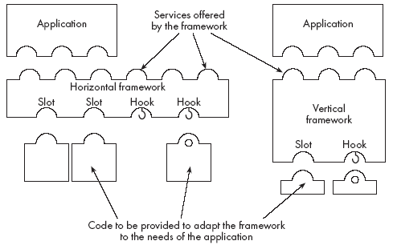
Types of frameworks
A horizontal framework provides general application facilities that a large number of applications can use
A vertical framework (application framework) is more ‘complete’ but still needs some slots to be filled to adapt it to specific application needs
© Lethbridge/Laganière 2005
Chap. 3: Basing Development on Reusable Technology

Slide 10
3.4 The Client-Server Architecture
A distributed system is a system in which:
  computations are performed by separate programs
  … normally running on separate pieces of hardware
  … that co-operate to perform the task of the system.
Server:
  A program that provides a service for other programs that connect to it using a communication channel
Client
  A program that accesses a server (or several servers) to obtain services
  A server may be accessed by many clients simultaneously
© Lethbridge/Laganière 2005
Chap. 3: Basing Development on Reusable Technology

Slide 11
Sequence of activities in a client-server system
  The server starts running
  The server waits for clients to connect. (listening)
  Clients start running and perform operations
    Some operations involve requests to the server
  When a client attempts to connect, the server accepts the connection (if it is willing)
  The server waits for messages to arrive from connected clients
  When a message from a client arrives, the server takes some action in response, then resumes waiting
  Clients and servers continue functioning in this manner until they decide to shut down or disconnect
© Lethbridge/Laganière 2005
Chap. 3: Basing Development on Reusable Technology

Slide 12
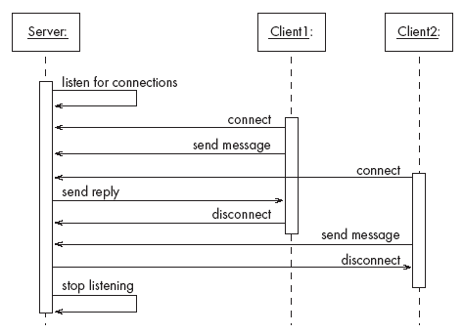
A server program communicating with two client programs
© Lethbridge/Laganière 2005
Chap. 3: Basing Development on Reusable Technology

Slide 13
Alternatives to the client server architecture
  Have a single program on one computer that does everything
  Have no communication
    Each computer performs the work separately
  Have some mechanism other than client-server communication for exchanging information
    E.g. one program writes to a database; the other reads from the database
© Lethbridge/Laganière 2005
Chap. 3: Basing Development on Reusable Technology

Slide 14
Advantages of client-server systems
  The work can be distributed among different machines
  The clients can access the server’s functionality from a distance
  The client and server can be designed separately
  They can both be simpler
  All the data can be kept centrally at the server
  Conversely, data can be distributed among many different geographically-distributed clients or servers
  The server can be accessed simultaneously by many clients
  Competing clients can be written to communicate with the same server, and vice-versa
© Lethbridge/Laganière 2005
Chap. 3: Basing Development on Reusable Technology

Slide 15
Example of client-server systems
  The World Wide Web
  Email
  Network File System
  Transaction Processing System
  Remote Display System
  Communication System
  Database System
© Lethbridge/Laganière 2005
Chap. 3: Basing Development on Reusable Technology

Slide 16
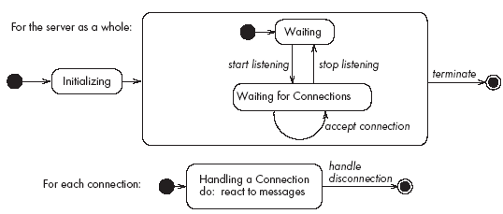
Activities of a server
Initializes itself
Starts listening for clients
Handles the following types of events originating from clients
  accepts connections
  responds to messages
  handles client disconnection
May stop
listening
Must cleanly terminate
© Lethbridge/Laganière 2005
Chap. 3: Basing Development on Reusable Technology

Slide 17
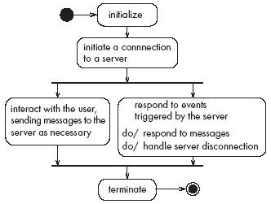
Activities of a client
Initializes itself
Initiates a connection
Sends messages
Handles the following types of events originating from the server
  responds to messages
  handles server disconnection
Must cleanly terminate
© Lethbridge/Laganière 2005
Chap. 3: Basing Development on Reusable Technology

Slide 18
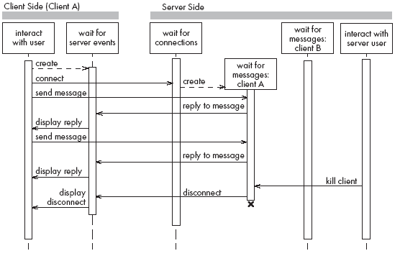
Threads in a client-server system
© Lethbridge/Laganière 2005
Chap. 3: Basing Development on Reusable Technology

Slide 19
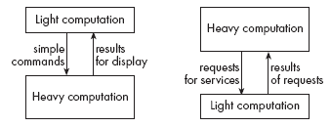
Thin- versus fat-client systems
Thin-client system (a)
  Client is made as small as possible
  Most of the work is done in the server.
  Client easy to download over the network
Fat-client system (b)
  As much work as possible is delegated to the clients.
  Server can handle more clients
© Lethbridge/Laganière 2005
Chap. 3: Basing Development on Reusable Technology

Slide 20
Communications protocols
  The messages the client sends to the server form a language.
    The server has to be programmed to understand that language.
  The messages the server sends to the client also form a language.
    The client has to be programmed to understand that language.
  When a client and server are communicating, they are in effect having a conversation using these two languages
  The two languages and the rules of the conversation, taken together, are called the protocol
© Lethbridge/Laganière 2005
Chap. 3: Basing Development on Reusable Technology

Slide 21
Tasks to perform to develop client-server applications
Design the primary work to be performed by both client and server
Design how the work will be distributed
Design the details of the set of messages that will be sent
Design the mechanism for
    Initializing
    Handling connections
    Sending and receiving messages
    Terminating
© Lethbridge/Laganière 2005
Chap. 3: Basing Development on Reusable Technology

Slide 22
3.5 Technology Needed to Build Client-Server Systems
Internet Protocol (IP)
  Route messages from one computer to another
  Long messages are normally split up into small pieces
Transmission Control Protocol (TCP)
  Handles connections between two computers
  Computers can then exchange many IP messages over a connection
  Assures that the messages have been satisfactorily received
A host has an IP address and a host name
  Several servers can run on the same host.
  Each server is identified by a port number (0 to 65535).
  To initiate communication with a server, a client must know both the host name and the port number
© Lethbridge/Laganière 2005
Chap. 3: Basing Development on Reusable Technology

Slide 23
Establishing a connection in Java
The java.net package
  Permits the creation of a TCP/IP connection between two applications
Before a connection can be established, the server must start listening to one of the ports:
    ServerSocket serverSocket = new
    ServerSocket(port);
    Socket clientSocket = serverSocket.accept();
For a client to connect to a server:
    Socket clientSocket= new Socket(host, port);
© Lethbridge/Laganière 2005
Chap. 3: Basing Development on Reusable Technology

Slide 24
Exchanging information in Java
  Each program uses an instance of
    InputStream to receive messages from the other program
    OutputStream to send messages to the other program
    These are found in package java.io
output = clientSocket.getOutputStream();
input = clientSocket.getInputStream();
© Lethbridge/Laganière 2005
Chap. 3: Basing Development on Reusable Technology

Slide 25
Sending and receiving messages
• without any filters (raw bytes)
    output.write(msg);
    msg = input.read();
• or using DataInputStream / DataOutputStream filters
    output.writeDouble(msg);
    msg = input.readDouble();
• or using ObjectInputStream / ObjectOutputStream filters
    output.writeObject(msg);
    msg = input.readObject();
© Lethbridge/Laganière 2005
Chap. 3: Basing Development on Reusable Technology

Slide 26
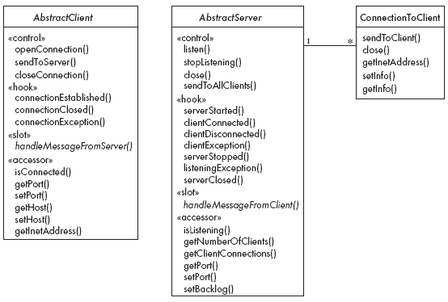
3.6 The Object Client-Server Framework
(OCSF)
© Lethbridge/Laganière 2005
Chap. 3: Basing Development on Reusable Technology

Slide 27
Using OCSF
Software engineers using OCSF never modify its three classes
They:
  Create subclasses of the abstract classes in the framework
  Call public methods that are provided by the framework
  Override certain slot and hook methods (explicitly designed to be overridden)
© Lethbridge/Laganière 2005
Chap. 3: Basing Development on Reusable Technology

Slide 28
3.7 The Client Side
Consists of a single class: AbstractClient
  Must be subclassed
    Any subclass must provide an implementation for handleMessageFromServer
      Takes appropriate action when a message is received from a server
  Implements the Runnable interface
    Has a run method which
      Contains a loop that executes for the lifetime of the thread
© Lethbridge/Laganière 2005
Chap. 3: Basing Development on Reusable Technology

Slide 29
The public interface of AbstractClient
Controlling methods:
  openConnection
  closeConnection
  sendToServer
Accessing methods:
  isConnected
  getHost
  setHost
  getPort
  setPort
  getInetAddress
© Lethbridge/Laganière 2005
Chap. 3: Basing Development on Reusable Technology

Slide 30
The callback methods of AbstractClient
Methods that may be overridden:
  connectionEstablished
  connectionClosed
Method that must be implemented:
  handleMessageFromServer
© Lethbridge/Laganière 2005
Chap. 3: Basing Development on Reusable Technology

Slide 31
Using AbstractClient
  Create a subclass of AbstractClient
  Implement handleMessageFromServer slot method
  Write code that:
    Creates an instance of the new subclass
    Calls openConnection
    Sends messages to the server using the sendToServer service method
  Implement the connectionClosed callback
  Implement the connectionException callback
© Lethbridge/Laganière 2005
Chap. 3: Basing Development on Reusable Technology

Slide 32
Internals of AbstractClient
Instance variables:
  A Socket which keeps all the information about the connection to the server
  Two streams, an ObjectOutputStream and an ObjectInputStream
  A Thread that runs using AbstractClient’s run method
  Two variables storing the host and port of the server
© Lethbridge/Laganière 2005
Chap. 3: Basing Development on Reusable Technology

Slide 33
3.8 The Server Side
Two classes:
  One for the thread which listens for new connections (AbstractServer)
  One for the threads that handle the connections to clients (ConnectionToClient)
© Lethbridge/Laganière 2005
Chap. 3: Basing Development on Reusable Technology

Slide 34
The public interface of AbstractServer
Controlling methods:
  listen
  stopListening
  close
  sendToAllClients
Accessing methods:
  isListening
  getClientConnections
  getPort
  setPort
  setBacklog
© Lethbridge/Laganière 2005
Chap. 3: Basing Development on Reusable Technology

Slide 35
The callback methods of AbstractServer
Methods that may be overridden:
  serverStarted
  clientConnected
  clientDisconnected
  clientException
  serverStopped
  listeningException
  serverClosed
Method that must be implemented:
  handleMessageFromClient
© Lethbridge/Laganière 2005
Chap. 3: Basing Development on Reusable Technology

Slide 36
The public interface of ConnectionToClient
Controlling methods:
  sendToClient
  close
Accessing methods:
  getInetAddress
  setInfo
  getInfo
© Lethbridge/Laganière 2005
Chap. 3: Basing Development on Reusable Technology

Slide 37
Using AbstractServer and ConnectionToClient
  Create a subclass of AbstractServer
  Implement the slot method handleMessageFromClient
  Write code that:
    Creates an instance of the subclass of AbstractServer
    Calls the listen method
    Sends messages to clients, using:
      the getClientConnections and sendToClient service methods
      or sendToAllClients
  Implement one or more of the other callback methods
© Lethbridge/Laganière 2005
Chap. 3: Basing Development on Reusable Technology

Slide 38
Internals of AbstractServer and ConnectionToClient
  The setInfo and getInfo methods make use of a Java class called HashMap
  Many methods in the server side are synchronized
  The collection of instances of ConnectionToClient is stored using a special class called ThreadGroup
  The server must pause from listening every 500ms to see if the stopListening method has been called
    if not, then it resumes listening immediately
© Lethbridge/Laganière 2005
Chap. 3: Basing Development on Reusable Technology

Slide 39
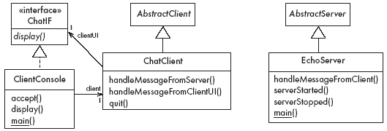
3.9 An Instant Messaging Application: SimpleChat
ClientConsole can eventually be replaced by ClientGUI
© Lethbridge/Laganière 2005
Chap. 3: Basing Development on Reusable Technology

Slide 40
The server
EchoServer is a subclass of AbstractServer
  The main method creates a new instance and starts it
    It listens for clients and handles connections until the server is stopped
  The three callback methods just print out a message to the user
    handleMessageFromClient, serverStarted and serverStopped
  The slot method handleMessageFromClient calls sendToAllClients
    This echoes any messages
© Lethbridge/Laganière 2005
Chap. 3: Basing Development on Reusable Technology

Slide 41
Key code in EchoServer
public void handleMessageFromClient
(Object msg, ConnectionToClient client)
{
System.out.println(
"Message received: "
+ msg + " from " + client);
this.sendToAllClients(msg);
}
© Lethbridge/Laganière 2005
Chap. 3: Basing Development on Reusable Technology

Slide 42
The client
When the client program starts, it creates instances of two classes:
  ChatClient
    A subclass of AbstractClient
    Overrides handleMessageFromServer
      This calls the display method of the user interface
  ClientConsole
    User interface class that implements the interface ChatIF
      Hence implements display which outputs to the console
    Accepts user input by calling accept in its run method
    Sends all user input to the ChatClient by calling its handleMessageFromClientUI
      This, in turn, calls sendToServer
© Lethbridge/Laganière 2005
Chap. 3: Basing Development on Reusable Technology

Slide 43
Key code in ChatClient
public void handleMessageFromClientUI(
String message)
{
try
{
sendToServer(message);
}
catch(IOException e)
{
clientUI.display (
"Could not send message. " +
"Terminating client.");
quit();
}
}
© Lethbridge/Laganière 2005
Chap. 3: Basing Development on Reusable Technology

Slide 44
Key code in ChatClient - continued
public void handleMessageFromServer(Object msg)
{
clientUI.display(msg.toString());
}
© Lethbridge/Laganière 2005
Chap. 3: Basing Development on Reusable Technology

Slide 45
3.10 Risks when reusing technology
  Poor quality reusable components
    Ensure that the developers of the reusable technology:
      follow good software engineering practices
      are willing to provide active support
  Compatibility not maintained
    Avoid obscure features
    Only re-use technology that others are also re-using
© Lethbridge/Laganière 2005
Chap. 3: Basing Development on Reusable Technology

Slide 46
Risks when developing reusable technology
  Investment uncertainty
    Plan the development of the reusable technology, just as if it was a product for a client
  The ‘not invented here syndrome’
    Build confidence in the reusable technology by:
      Guaranteeing support
      Ensuring it is of high quality
      Responding to the needs of its users
© Lethbridge/Laganière 2005
Chap. 3: Basing Development on Reusable Technology

Slide 47
Risk when developing reusable technology – continued
  Competition
    The reusable technology must be as useful and as high quality as possible
  Divergence (tendency of various groups to change technology in different ways)
    Design it to be general enough, test it and review it in advance
© Lethbridge/Laganière 2005
Chap. 3: Basing Development on Reusable Technology

Slide 48
Risks when adopting a client-server approach
  Security
    Security is a big problem with no perfect solutions: consider the use of encryption, firewalls, ...
  Need for adaptive maintenance
    Ensure that all software is forward and backward compatible with other versions of clients and servers
© Lethbridge/Laganière 2005
Chap. 3: Basing Development on Reusable Technology

